Slide 1
Ensemble Learning

Slide 2
Intro
We introduce ensemble classifiers, that is, machine learning based classifiers that utilize a combination of scoring functions

Slide 3
Intro
In ensemble learning, multiple learning algorithms are combined, with the goal of improved accuracy as compared to the individual algorithms
Ensemble techniques are widely used, and as a testament to their strength, ensembles have won numerous machine learning contests in recent years, including the KDD Cup, the Kaggle competition, and the Netflix prize
Unfortunately, they aim to accuracy more than efficiency, and in real-world systems, practicality and efficiency are necessarily crucial factors
Notes:
In the case of the Netflix prize, the winning team was awarded $1,000,000, yet Netflix never implement the winning scheme, since the improvements in accuracy “did not seem to justify the engineering effort needed to bring them into a production environment”

Slide 4
Ensemble Classifiers
There are various ways to combine classifiers, for example straightforward combinations, such as a maximum, sum, product, majority vote, and so on
These approaches are classic, we will see also something “different”

Slide 5
A Framework for Ensemble Classifiers
We consider ensemble learners that are based on combinations of scoring functions
Note that we place no additional restrictions on the scoring functions and, in particular, they do not necessarily represent “learning” algorithms, per se.
Hence, we are dealing with ensemble methods broadly speaking, rather than ensemble learners in a strict sense
We assume that the ensemble method itself—as opposed to the scoring functions that comprise the ensemble—is for classification, and hence ensemble functions are 0-1 loss functions
In a 0-1 loss function you simply count the number of misclassified items

Slide 6
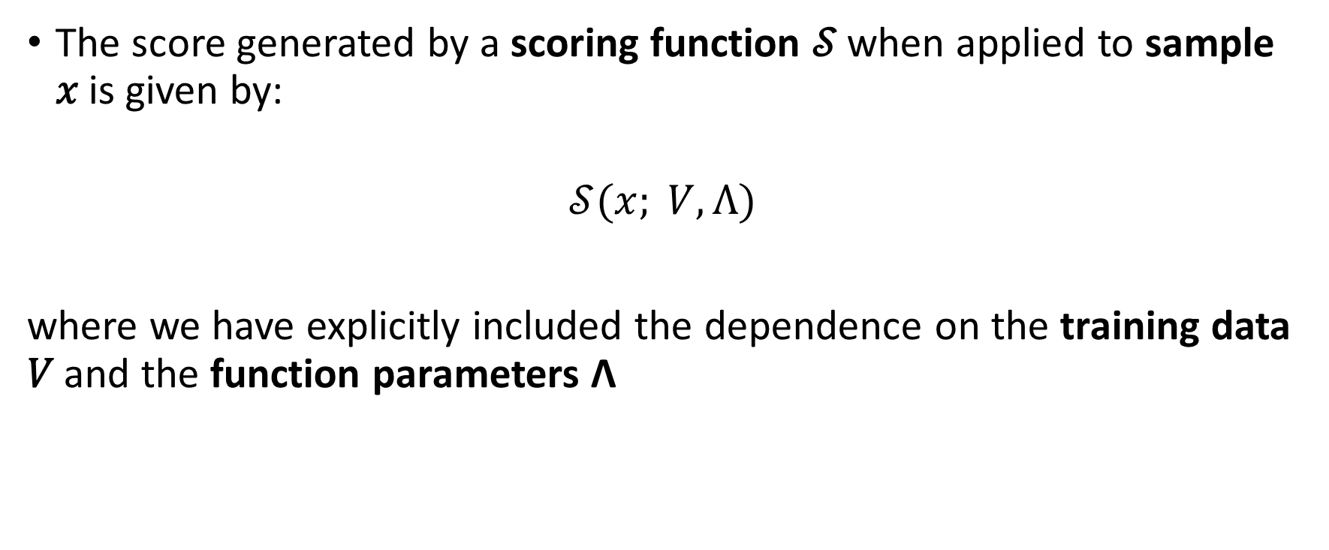
Notation
The score generated by a scoring function 𝒮 when applied to sample 𝑥 is given by:
$$𝒮(x; V, Λ)$$
where we have explicitly included the dependence on the training data 𝑉 and the function parameters Λ

Slide 7

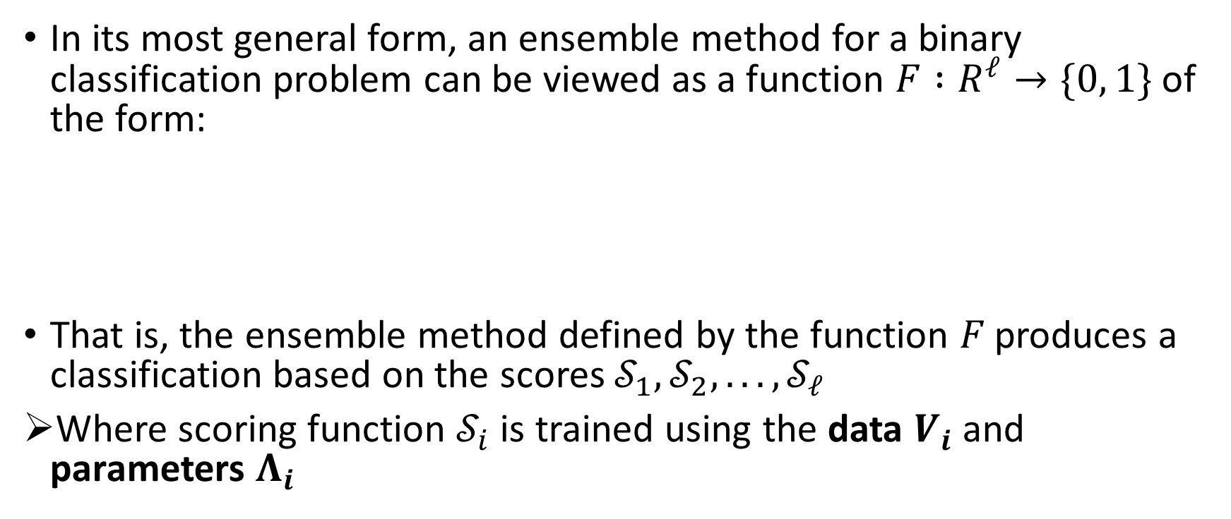
Notation
In its most general form, an ensemble method for a binary classification problem can be viewed as a function $F :R^{ℓ}→\{0, 1\}$of the form:
That is, the ensemble method defined by the function 𝐹 produces a classification based on the scores $𝒮_{1}, 𝒮_{2}, . . . , 𝒮_{ℓ}$
Where scoring function $𝒮_{i}$is trained using the data $V_{i}$ and parameters $Λ_{i}$

Slide 8
Classifying Ensemble Classifiers
From a high-level perspective, ensemble classifiers can be categorized as bagging, boosting, stacking, or some combination thereof

Slide 9
Bagging
In bootstrap aggregation (i.e., bagging), different subsets of the data or features (or both) are used to generate different scores
The results are then combined in some way, such as a sum of the scores, or a majority vote of the corresponding classifications
For bagging we assume that the same scoring method is used for all scores in the ensemble.
One benefit of bagging is that it reduces overfitting
Notes:
For example, bagging is used when generating a random forest, where each individual scoring function is based on a decision tree structure

Slide 10

Bagging
For bagging, the general equation is restricted to:
That is, in bagging, each scoring function is essentially the same, but each is trained on a different feature set
Notes:
Of course, we can easily extend this to bagging based on both the data and features simultaneously, as in a random forest

Slide 11
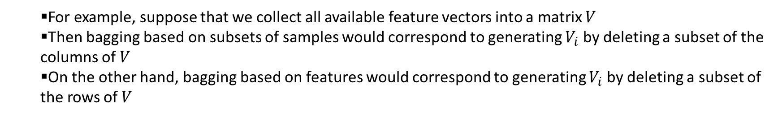
Sample 1
Sample 2
Sample 3
Matrix V
Feature 1 | Feature 1 | Feature 1
Feature 2 | Feature 2 | Feature 2
Feature 3 | Feature 3 | Feature 3
Feature 4 | Feature 4 | Feature 4
Feature 5 | Feature 5 | Feature 5
Feature 6 | Feature 6 | Feature 6
Feature 7 | Feature 7 | Feature 7
For example, suppose that we collect all available feature vectors into a matrix 𝑉
Then bagging based on subsets of samples would correspond to generating $V_{i}$ by deleting a subset of the columns of 𝑉
On the other hand, bagging based on features would correspond to generating $V_{i}$ by deleting a subset of the rows of 𝑉

Slide 12
Boosting
Boosting is a process whereby distinct classifiers are combined to produce a stronger classifier
Generally, boosting deals with weak classifiers that are combined in an adaptive or iterative manner to improve the overall classifier
We restrict our definition of boosting to cases where the classifiers are closely related, in the sense that they differ only in terms of parameters

Slide 13

Boosting
From this perspective, boosting can be viewed as “bagging” based on classifiers, rather than data or features
That is, all of the scoring functions are reparametrized versions of the same scoring technique
Under this definition of boosting, the general equation becomes:
That is, the scoring functions differ only by re-parameterization, while the scoring data and features do not change
We will see a specific examples of boosting, that is, the most popular method known as AdaBoost

Slide 14
Stacking
Stacking is an ensemble method that combines disparate scores using a metaclassifier
In this generic form, stacking is defined by the general case in equation, where the scoring functions can be (and typically are) significantly different
Note that from this perspective, stacking is easily seen to be a generalization of both bagging and boosting
Because stacking generalizes both bagging and boosting, it is not surprising that stacking based ensemble methods can outperform bagging and boosting methods

Slide 15
Stacking
However, this is not the end of the story, because stacking introduces a large overhead
Of course, the appropriate tradeoffs will depend on the specifics of the problem at hand

Slide 16

Ensemble Methods
Bagging:
Same Scoring function with the same parameters $Λ$, but training data/features wary
Boosting:
Same Scoring function with the same training data/features, but different parameters $Λ$
Stacking
Totally different Scoring functions combined via a meta-classifier

Slide 17
Ensemble Classifier Examples
Here, we consider a variety of ensemble methods
We begin with a few generic examples, and then discuss several more specific examples.

Slide 18
Maximum
In this case, we have:

Slide 19
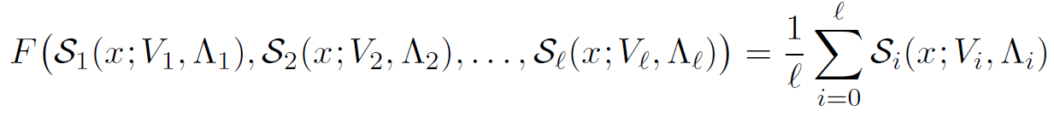
Averaging
In this case, we have:

Slide 20
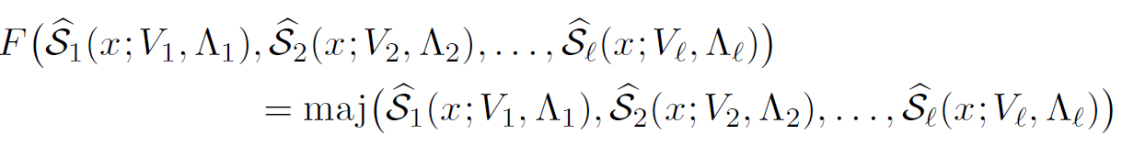
Voting
Voting could be used as a form of boosting, provided that no bagging is involved (i.e., the same data and features are used in each case)
Voting is also applicable to stacking, and in the case of stacking, a simple majority vote is of the form:
where “maj” is the majority vote function
Note that the majority vote is well defined in this case, provided that ℓ is odd—if ℓ is even, we can simply flip a coin in case of a tie

Slide 21
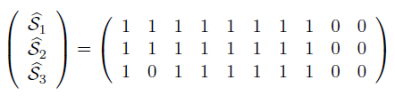
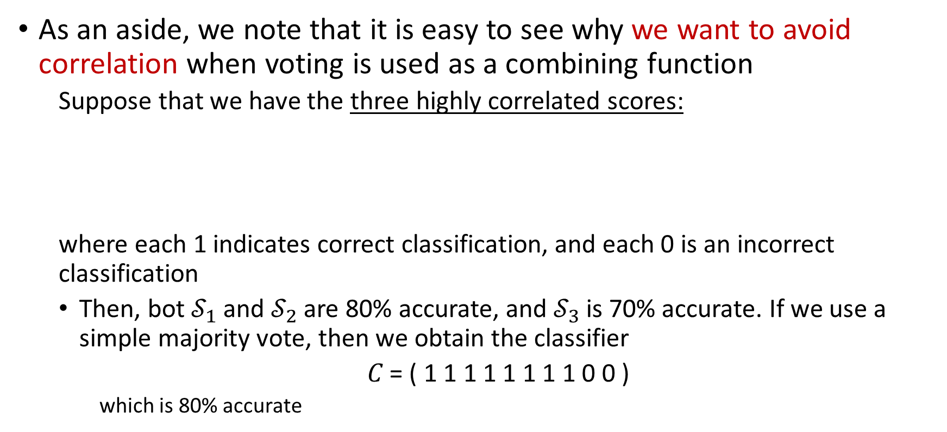
Voting
As an aside, we note that it is easy to see why we want to avoid correlation when voting is used as a combining function
Suppose that we have the three highly correlated scores:
where each 1 indicates correct classification, and each 0 is an incorrect classification
Then, bot $𝒮_{1}$ and︀ $𝒮_{2}$ are 80% accurate, and︀ $𝒮_{3}$ is 70% accurate. If we use a simple majority vote, then we obtain the classifier
𝐶 = ( 1 1 1 1 1 1 1 1 0 0 )
which is 80% accurate

Slide 22
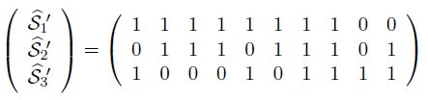
Voting
On the other hand, the less correlated classifiers:
are only 80%, 70% and 60% accurate, respectively, but the majority vote in this case gives us
𝐶′ = ( 1 1 1 1 1 1 1 1 0 1 )
which is 90% accurate

Slide 23
ML-Based Combination
Recall that the most general formulation of an ensemble classifier is given by:
In this formulation, we can select the function 𝐹 based on a machine learning technique

Slide 24
SVM as Meta-Classifier
It is natural to use an SVM as a meta-classifier to combine scores
The use of SVM in this meta-classifier mode can be viewed as a general stacking method
Thus, this SVM technique is equivalent to the equation:
where the function 𝐹 is simply an SVM classifier based on the component scores

Slide 25
HMM with Random Restarts
A hidden Markov model can be viewed as a discrete hill climb technique
As with any hill climb, when training an HMM we are only assured of a local maximum, and we can often significantly improve our results by executing the hill climb multiple times with different initial values, and selecting the best of the resulting models
An HMM with random restarts can be seen as special case of boosting
If we simply select the best model, then the “combining” function is particularly simple, and is given by:

Slide 26
HMM with Random Restarts
Here, each scoring function is an HMM, where the trained models differ based only on different initial values
Note that the “max” is the maximum over the HMM model scores, not the maximum over any particular set of input values
That is, we select the highest scoring model and use it for scoring
Of course, we could use other combining functions, such as an average or majority vote of the corresponding classifiers
In any case, since there is a score associated with each model generated by an HMM, any such combining function is well-defined

Slide 27

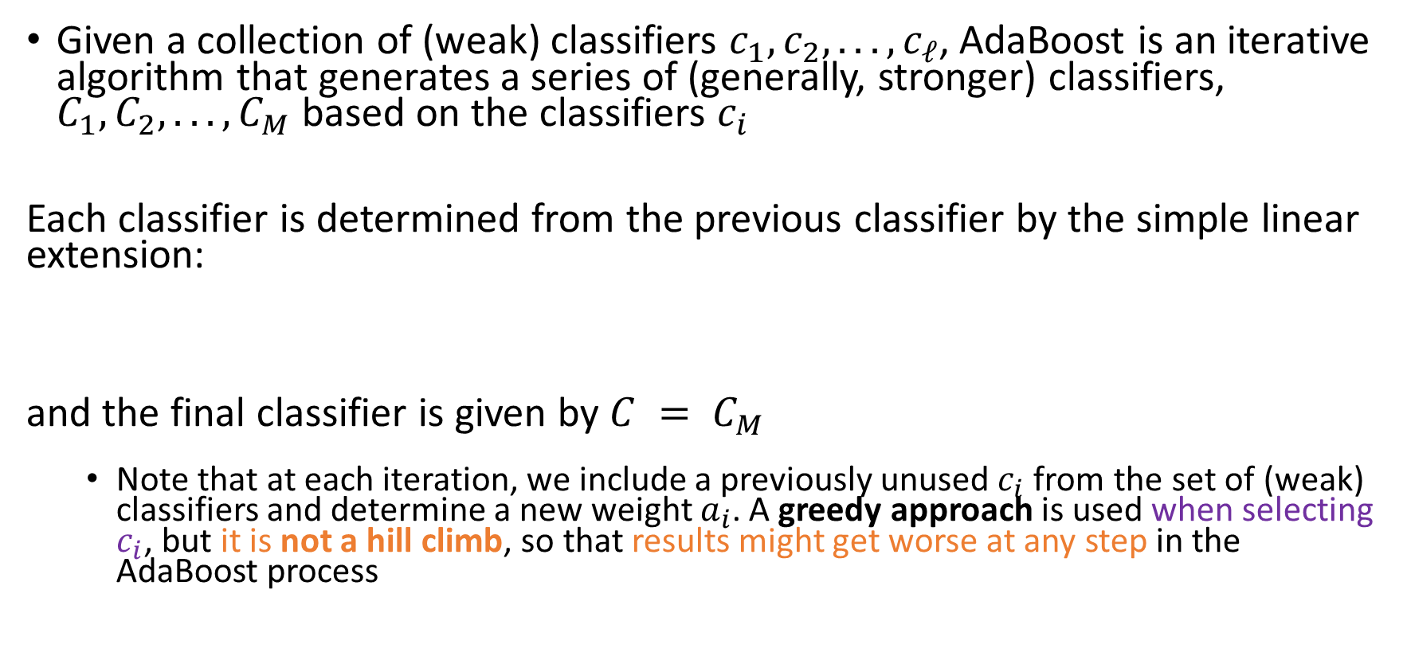
AdaBoost
Given a collection of (weak) classifiers $c_{1}, c_{2}, . . . , c_{ℓ}$, AdaBoost is an iterative algorithm that generates a series of (generally, stronger) classifiers, $C_{1},C_{2}, . . . ,C_{M}$ based on the classifiers $c_{i}$
Each classifier is determined from the previous classifier by the simple linear extension:
and the final classifier is given by $C = C_{M}$
Note that at each iteration, we include a previously unused $c_{i}$ from the set of (weak) classifiers and determine a new weight $a_{i}$. A greedy approach is used when selecting $c_{i}$, but it is not a hill climb, so that results might get worse at any step in the AdaBoost process

Slide 28

AdaBoost
From this description, we see that AdaBoost fits the form
and:

Slide 29
AdaBoost
AdaBoost is certainly the best-known boosting technique
At each iteration, AdaBoost selects the “best” classifier from those available
Where “best” is defined as the classifier that most improves on the overall accuracy of the new, combined classifier
That is, AdaBoost greedily selects a classifier that does the most to improve on the current iteration of the constructed classifier
In AdaBoost the selected classifiers are combined as a weighted linear combination, where an optimal weight is calculated at each iteration, with all previously computed weights fixed
Notes:
While AdaBoost has many desirable properties, one inherent problem is that errors in the training data tend to grow, due to the iterative nature of the algorithm

